Slide 1
The Dangerous of Obesity
Mohamed Ali (Leader)
Hoa Pham
Tien Tran

Slide 2
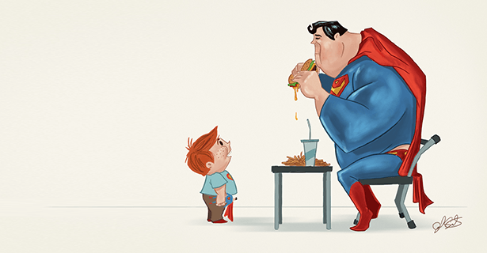
What is Obesity ?
Obesity means having too much body fat.
Obesity happens over time when you eat more calories than you use.

Slide 3
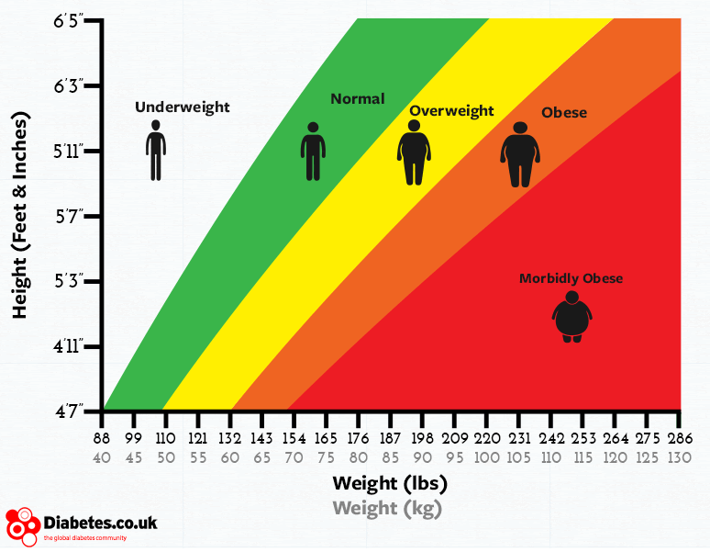
“Obesity or Not Obesity”

Slide 4
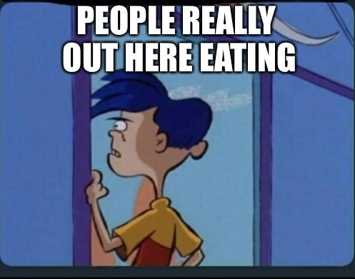
Causes
Genetic
Sugar
Misinformation
Certain Medications

Slide 5
Diseases
Heart Disease and Stroke
Cancer
Breathing Problem

Slide 6
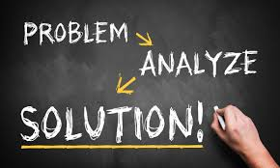
Solutions
Information
Meal Plan (weekly)
Exercises

Slide 7
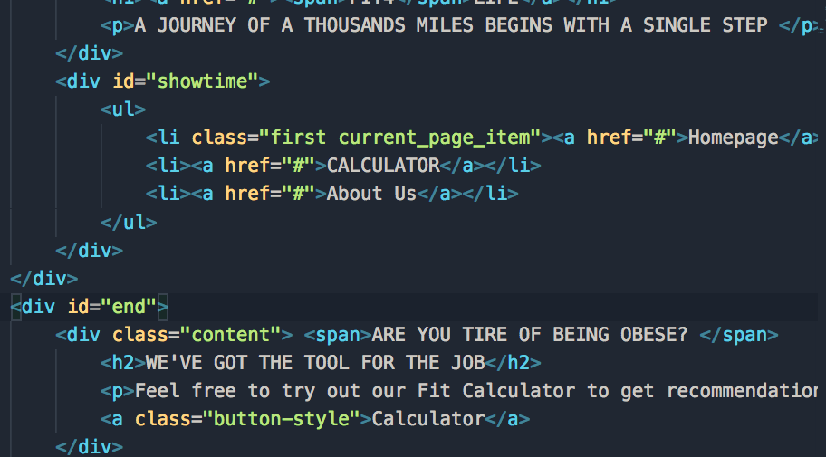
HTML

Slide 8
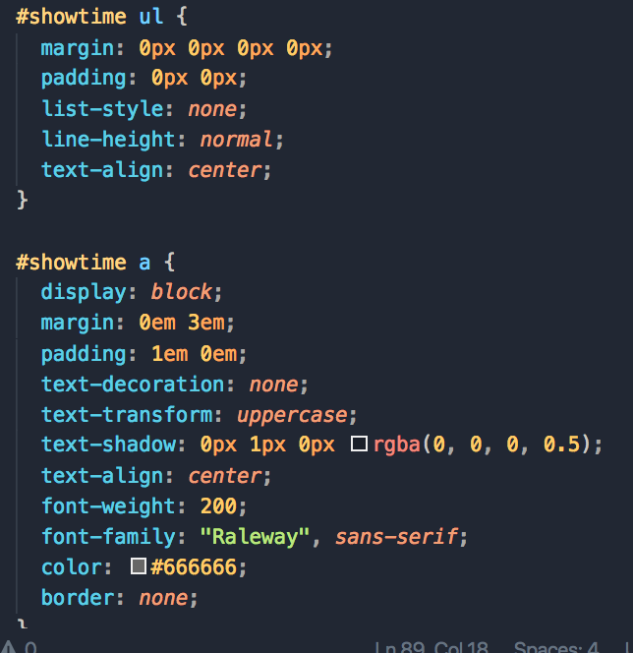
CSS

Slide 9
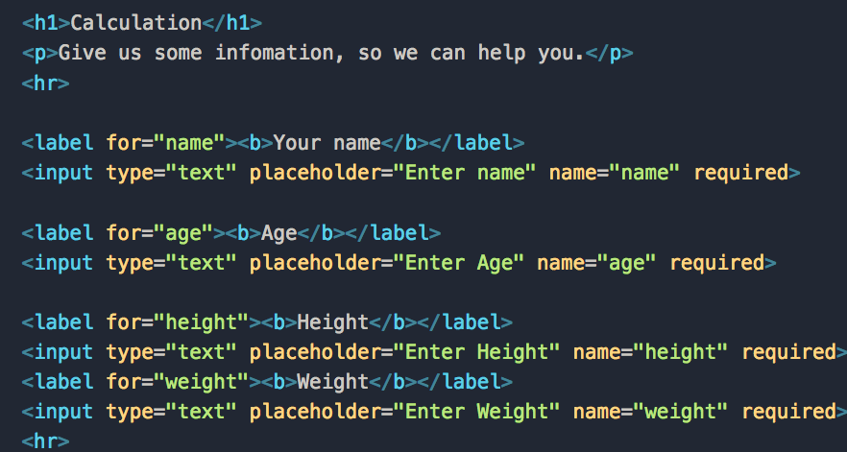
HTML

Slide 10
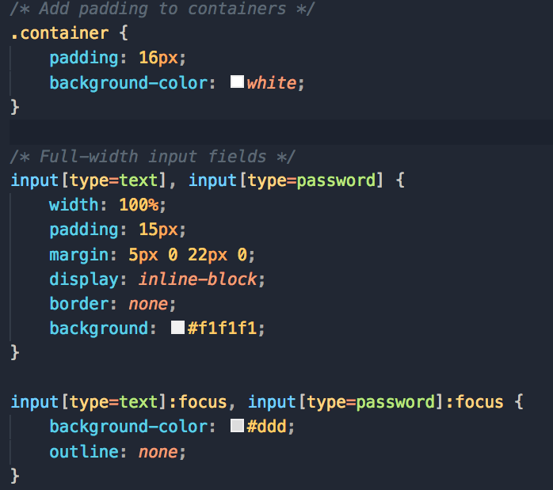
CSS

Slide 11
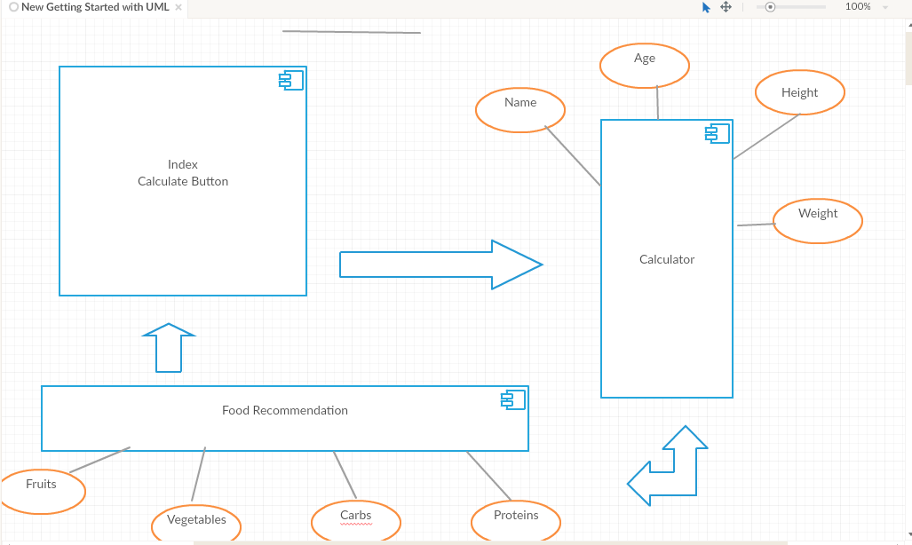
UML

Slide 12
Demo

Slide 13
Q&A

